Slide 1

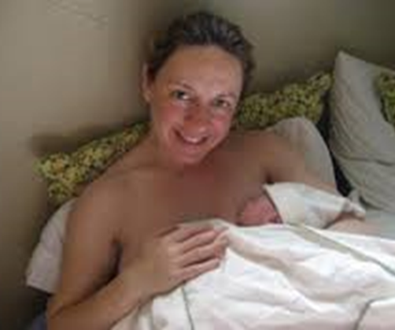


Introduction to BSc Midwifery programme
2024 - 2028

Slide 2

Overview
Introductions
Overview of BSc Midwifery programme
Q & A

Slide 3

Introductions
Name
Where you are from/living?
Hobbies/talents
Why you chose Midwifery?

Slide 4



BSc Midwifery Programme
4-year Undergraduate Degree Programme
September 2024 - September 2028
UCD: Awarded Hons BSc Degree
Nursing and Midwifery Board of Ireland Register to work as a Registered Midwife

Slide 5

BSc Midwifery Curriculum-Stage One https://www.nmbi.ie/Education/Standards-and-Requirements/Midwife-Registration-Programmes
  Trimester One (September – December 2024)
  Scientific Principles for Healthcare (1)
  Introduction to Psychology and Communication
  Academic reading & writing
  Midwifery-Specific
  Essence of Midwifery Practice (10cr)
  Trimester Two (Clinical 11 weeks/theory 4 weeks)
  Scientific Principles for Healthcare (2)
  Midwifery-Specific
  Labour & Birth
  Promoting Women's Health

Slide 6
Stage 1 Theory/Clinical Map
Trimester 1:
Orientation: 4th & 5th September 2024
Theory UCD: 9th September-2nd December x 12 weeks
Reading week: 28th October- 4th November
Revision weeks: 2nd – 8th December
Exam weeks: 09th – 21st December
Trimester 2:
Clinical Placements: 13th January-15th February 2024 (5 weeks)
UCD: 17th Feb - 15th March (4 weeks)
Midterm: Week of 17th^{th} March (1 week)
Clinical placements: 24th March-3rd May (6 weeks)
Exam weeks: 5th -18th May (Spring trimester modules)

Slide 7




Clinical Placements
1st year
1st year (11 weeks clinical placement) 13/01/2025
  Antenatal, Labour, Postnatal
  NMH, Mullingar or Kilkenny

Slide 8

Travel and Accommodation Allowance
Nursing and midwifery students in first to third year may claim allowances while on clinical placement.
HSE HR Circular 9/2004
Accommodation allowance up to but not exceeding €50.79 weekly for the duration of the placement where it is necessary for the student to obtain accommodation away from his/her normal place of residence”.
Weekly travel allowance of €24.00 approx. (Weekly Student Rambling Leap Card)
NMH allocations officer collates this amount at the end of the student's clinical placement and send it to NMH Salaries department in May each year
Students receive the amount usually in June each year when supernumerary placements are complete
Paid directly into bank accounts. Make sure that NMH have your bank account details
More details to follow during Orientation to hospital

Slide 9
4-year BSc Midwifery Programme
Year 1
Autumn Trimester
Sept-Dec (UCD)
Spring Trimester
Clinical Placement x 5 weeks
UCD x 4 weeks
Clinical Placement x 6 weeks
Assessments
Year 2
Autumn Trimester
Sept-Dec (UCD)
Spring Trimester
Clinical Placements
IEHG hospitals
Specialist placements
Year 3
Autumn Trimester
UCD x 2 weeks (end August)
Clinical Placements
IEHG hospitals
Specialist placements
Spring Trimester
Jan-May (UCD)
Year 4
Autumn trimester
Mid Aug x 4 weeks (Clinical placement)
Sept-Dec (UCD)
Spring Trimester
Internship Clinical Placements
Summer Trimester
Internship Clinical Placements

Slide 10
The Midwifery Student Journey
Midwifery skills
Anatomy & Physiology,
Psychology & Communication
Transition to University
Labour & Birth
Promoting Health
Postnatal care
Newborn
Specialist Midwifery
Patient Safety
Microbiology
Pharmacology
Elective x 1
Complexities of pregnancy, labour, newborn
Ethics & Legal
Sociology
Elective x 2
Obstetric Emergencies
Midwifery
Leadership & Management
Preparation for Internship
Research
YEAR 1 1
YEAR 2
YEAR 3
YEAR 4
Specialist Midwifery & Community
Introduction to Midwifery
Internship (paid)
Notes:
Personal tutor roles
Year 1: Feedback from first assessment
Identifying support needs
Effective referrals
Academic support
Reflect on development of graduate skills and attributes
Review of academic progress
Planning for year 2
Year 2:
Reviewing academic progress on programme
Discussion of feedback and marks identifying overarching issues
Reflecting upon graduate skills and attributes
Identification of skills gaps
Academic planning:
Course choices for level 3
Placement/internship application/preparation
Linking to careers service support

Slide 11
NMBI core clinical requirements and Location
Core Placements | NMBI Requirement | Location | Year of programme
Antenatal | 16 weeks | NMH/ Wexford/Kilkenny/ Mullingar | Stage 1, Stage 2, 3 or 4 supernumerary Internship
Intranatal | 16 weeks | NMH Wexford, Kilkenny, Mullingar | Stage 1 Stage 2, 3 or 4 supernumerary Internship
Postnatal | 14 weeks | NMH Wexford, Kilkenny, Mullingar | Stage 1 Stage 2, 3 or 4 supernumerary Internship
Midwifery-Led Care | 4 weeks | NMH Wexford, Kilkenny | Stage 2, 3 or 4 supernumerary
High Dependency Unit | 2 weeks | 1 week NMH 1 week SVUH | Stage 2 or Stage 3
Neonatal Unit | 4 weeks | NMH | Stage 2, 3 or 4 supernumerary

Slide 12
NMBI Specialist clinical requirements and Location
Specialist Placements | NMBI Requirement | Location | Year programme
Gynaecology | 4 weeks | NMH | Stage 2 & Stage 3
Mental Health | 2 weeks | SJG | Stage 2 or Stage 3
Theatre & Recovery | 1 week | NMH | Stage 2 or Stage 3
Primary Healthcare | 2 weeks | North/South Dublin PHN area | Stage 2 or Stage 3
Elective Placement | 2 weeks | Students own choice | Stage 2 or Stage 3

Slide 13
Clinical Placements Year 1-3
Supernumerary
Supervised and assessed by a qualified midwife
Varying levels of supervision as proceed through programme
Direct supervision (Stage 1)
Close supervision (Stage 2)
Indirect Supervision (Stage 3)
Distant supervision (Stage 4)

Slide 14

Clinical Placements 4th Year
January to September 2028
Internship 36 weeks
Paid employee of National Maternity Hospital

Slide 15
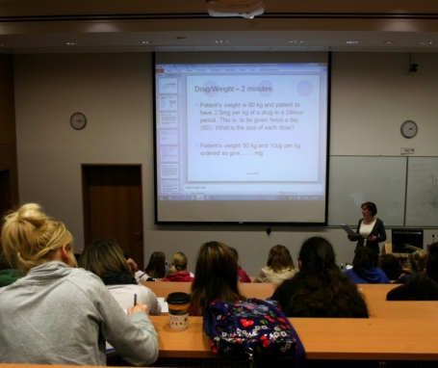

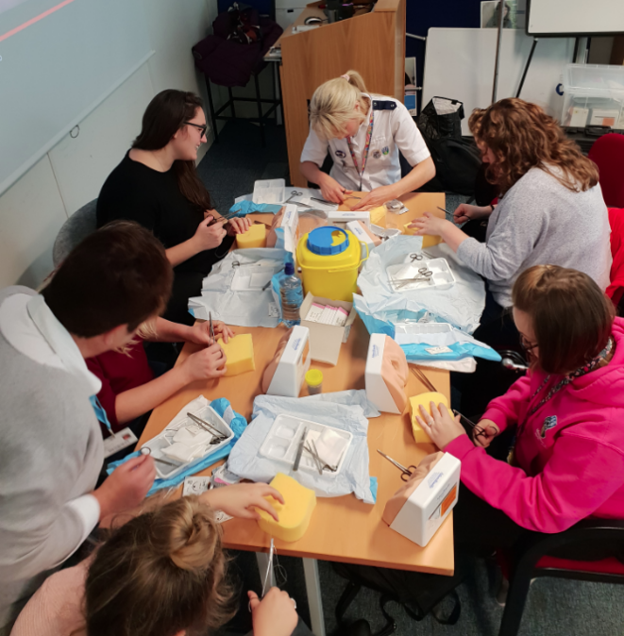
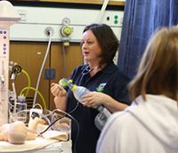

How will you learn?
Lectures (Brightspace)
  Campus lectures
  ‘live’ Zoom
  Pre-recorded
Scenario based learning
Problem – based learning
Tutorials
Workshops
Presentation skills
E-learning/online activities
Notes:
15

Slide 16
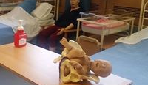


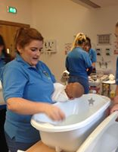
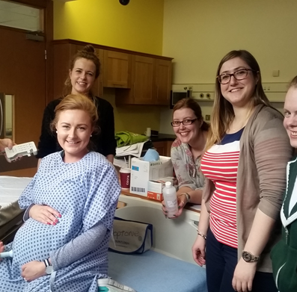
How will you learn?

Slide 17
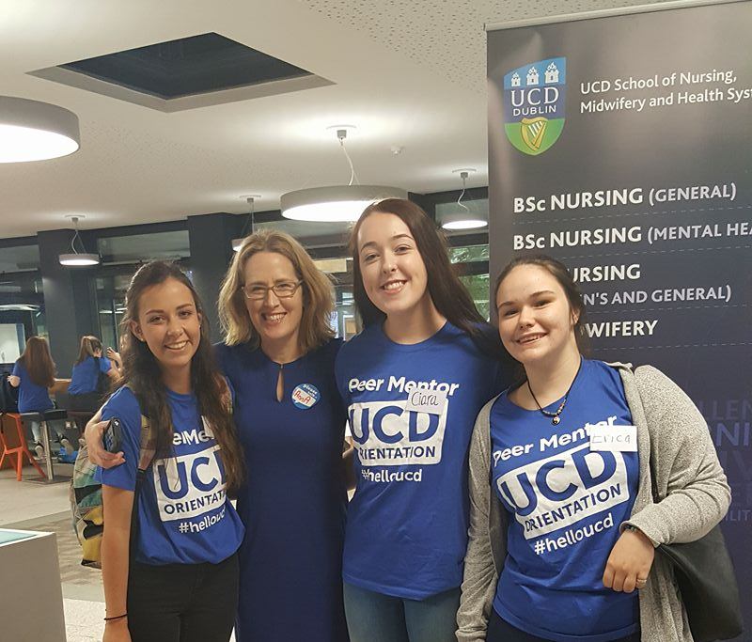

UCD School of Nursing, Midwifery and Health Systems: Student Supports
Programme Office
Personal Tutor: Dr Paula Cornally, Dr Denise O’Brien
Student Advisor
Chaplain
Disability support
Peer mentors
Stage and Programme Directors
Lecturers
Clinical Midwifery Tutor (Jennifer Dempsey)
UCD-Wide Supports
Student Desk
Student Health Services
International Office
UCD Access

Slide 18


Further Information
www.nmhs.ucd.ie
https://www.nmbi.ie/Education/Undergraduate-programmes
https://www.nmbi.ie/Careers-in-Nursing-Midwifery/Why-midwifery
www.nmh.ie
www.hse.ie

Slide 19






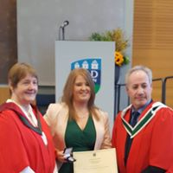
Opportunities during the Programme

Slide 20
Erasmus opportunity 2nd year
Henallux University, Belgium
8-9 weeks
Trimester 2
Clinical placements in a Belgium maternity unit
Mandatory Requirements: French language
More details to follow later in the year
Erasmus link: Dr. Lorraine Carroll

Slide 21

@ucdmidwifery
@ucdsnmhs

Slide 22


UCD requirements
Uniform fitting: You will be contacted by the School Office with information regarding your Uniform Fitting
Each module coordinator will tell you about reading list for modules

Slide 23
Purchase Clinical Skills Polo Shirt (Compulsory)
Where?: you will be directed to purchase the polo-shirt straight after you collect your UCARD in the same Building 71
Cost: €19.95
Payment Method: Visa/debit card payment only

Slide 24
Purchase Clinical Skills Items (Clinical Lite Stethoscope, Fob Watch, Aneroid Sphygmomanometer)
Where?: Student's Union Shop, Ground Floor James Joyce Library Building
Cost: €76.
Payment Method: The shop will accept cash or visa/debit cards (no UCARDs)
Opening Hours Monday to Thursday 8.30am to 6pm, Friday 08.30am to 4pm.

Slide 25

Purchase Workbook for Clinical Skills
Where?: Copi-Print Shop, Newman Building (Arts) in the J/K Area.
Cost € TBC once printed.
Payment Method: Copi print will accept cash, visa/debit card or UCARD
Opening Hours Monday to Friday, 9am to 5pm

Slide 26

Introduction to Brightspace
Virtual learning Environment (VLE)
https://brightspace.ucd.ie/d2l/le/content/6606/viewContent/181598/View?ou=6606
https://brightspace.ucd.ie/d2l/le/content/6606/viewContent/191725/View?ou=6606

Slide 27

Academic Skills &
Well-being
Note taking
Writing skills
Study skills
Referencing
Self-care
Academic reading
&
Writing module
Module Coordinator:
Dr Timmy Frawley

Slide 28
Getting ready for success and clinical placements -Mandatory Requirements
Check UCDconnect emails daily
Ensure that you are timetabled for:
  Manual handling – NMHS10480 on either 27th of September, 4th of October or 11th of October
  Basic Life Support – NMHS10480 18th of Oct, 25th of Oct or 1st of November.
Complete Garda Vetting asap – takes weeks to obtain, needed prior to clinical placement in January 2025
Attend occupational health appointments for vaccination even if the time clashes with your lecture or clinical skills timetable
COVID vaccination requirements
ACADEMIC ADVISORY: 14th November 2-4 pm in Scientific Principles Module (NMHS10480) COMPULSORY ATTENDANCE
Orientation to Clinical Practice Placement (National Maternity Hospital 1st Floor Lecture theatre in 65/66 Mount Street for Monday 13th January 2025 for the Orientation.
COMPULSORY ATTENDANCE
HSEland E-learning IP&C, Children’s First

Slide 29



Slide 30



Slide 31











Slide 32
Career opportunities
Registered Midwife(RM) with Nursing and Midwifery Board of Ireland
Hospital and community settings in Ireland
Opportunities to work abroad in Canada, Australia and New Zealand, UK
Clinical manager
Clinical midwifery specialist e.g. diabetes, ultrasound, bereavement
Lactation consultant, specialises in breastfeeding
Midwifery lecturer
Self employed community midwife
A practice midwife working with a GP
Researcher

Slide 33
Monday 9th September 2024
NMHS10390 Essence of Midwifery Practice
Introduction to the module
Answer any questions

Slide 34

Car parking at UCD
Parking PIN
Find in INFOHUB under the Campus Facilities menu
Applying for a UCD Parking Permit
1. Log onto the Parking Permit web page and select the link to apply for a parking permit
2. Create an account
3. Nominate your car registration number
4. Pay any charges due
Check carefully the details on the confirmation email issued following completion of the registration process.

Slide 35

Remember…
Normal to feel overwhelmed, lost, unsure in the first few weeks
Student Supports on clinical placements
We are here to help, support and guide you
Just ask!
www.nmhs.ucd.ie/contact-us

Slide 36

Any Questions?
Best of Luck in your midwifery career

